Slide 1
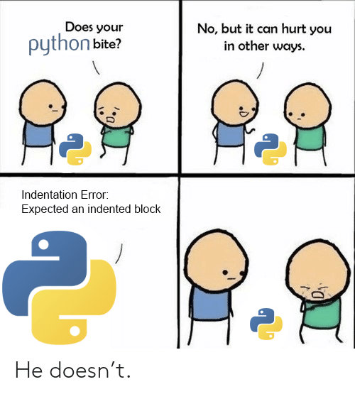
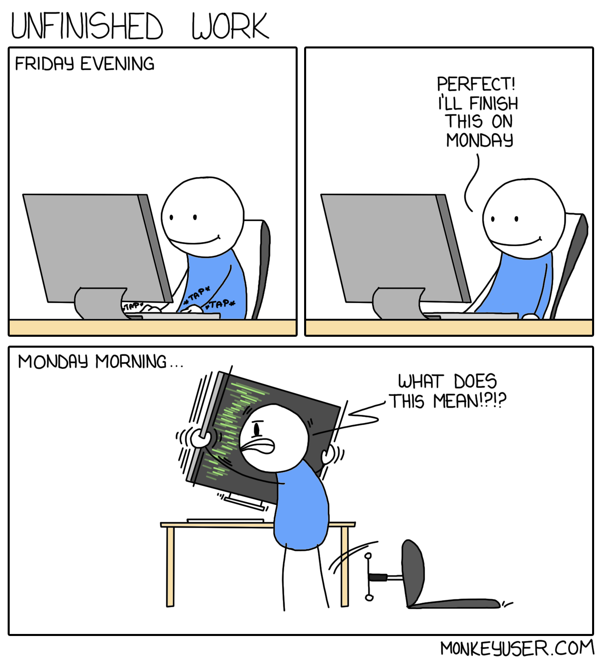
COMP2041
Week 9

Slide 2
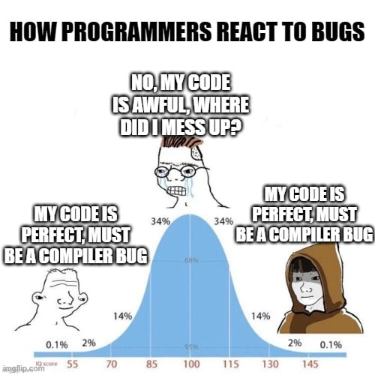
Announcements
Welcome to Week 9 of COMP2041
Week 8 Weekly Test due Thursday 9PM AEST
Week 8 Labs due at 12PM Monday
I haven’t got automarks for Ass1
Really got no clue when the marks will be released
No information has been released to us

Slide 3
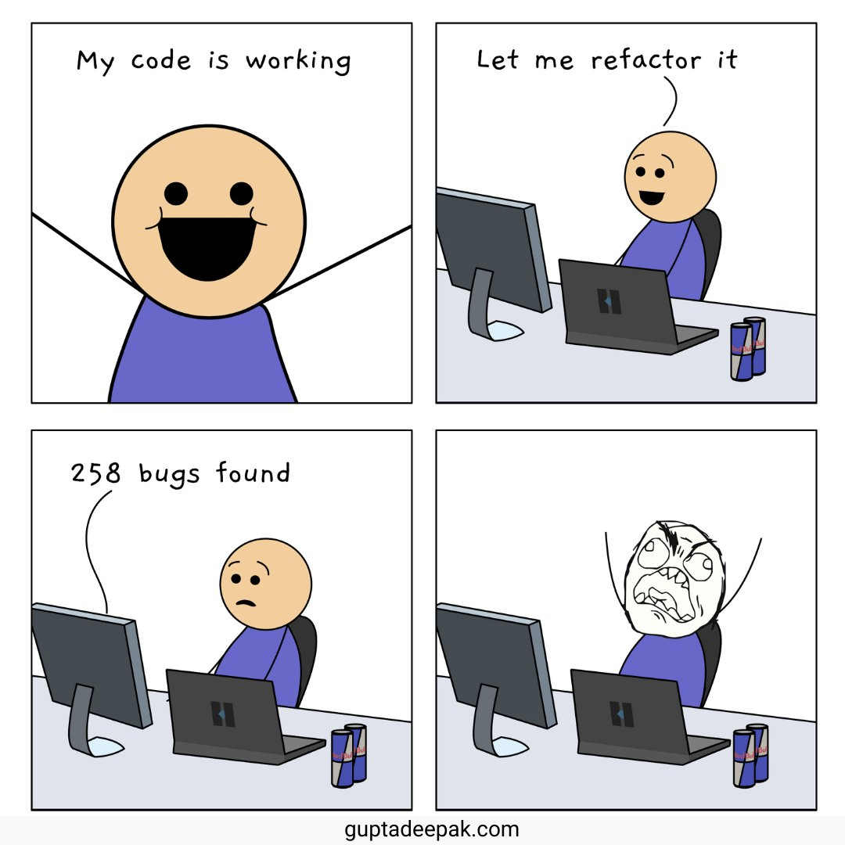
Overview
More Python Programming
Assignment 2
myExperience

Slide 4
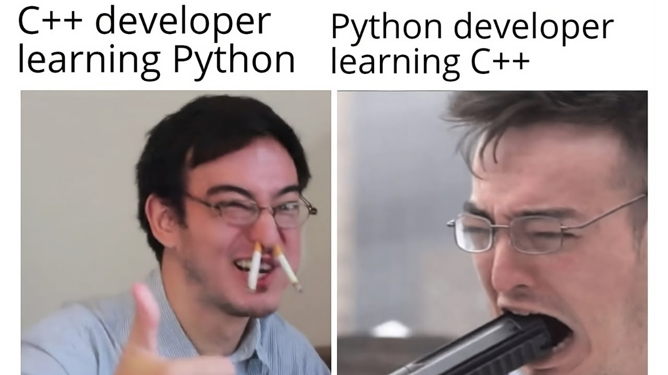
Useful Python stuff
cd: os.chdir('/path/to/directory')
mkdir: os.mkdir('/path/to/directory')
Check directory exists: os.path.isdir('/path/to/directory')
Get current directory: os.getcwd()
Write to file: with open('example.txt', 'w') as file: file.write("Text") file.write(“Overwriting text")
Append to file: with open('example.txt', 'a') as file: file.write("Text appended") file.write(“Text appended again")
Check file exists: os.path.exists(‘example.txt’)
filecmp also useful (https://docs.python.org/3/library/filecmp.html)
Globbing explained last week

Slide 5
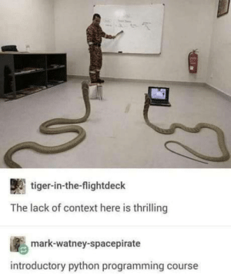
Assignment 2 Structure (1)
grip-init: Creates an empty git repository
Make additional files (e.g. txt file to store commit messages)
Also make /index folder and /commits folder to store all of your files
grip-add <files>
Loops through sys.argv and adds all files to /index folder
grip-commit -m ‘message’
1. Adds a new folder ‘0’, after checking there are no previous commits (If there exists a folder 2, create a new folder ‘3’)
2. Copies all stuff from /index to /commits/0
3. Append corresponding commit message for commit number (txt file)
grip-log
Assuming you made a .txt file for storing commit messages, just read it out (except edge cases)
grip-show
grip-show 2:file.txt -> gives commit2 version of file.txt
grip-show :file.txt -> gives file.txt stored in index
.grip/index/file.txt
.grip/commit_logs.txt
.grip/index/file.txt
.grip/commits/0/file.txt
.grip/commits/1/file.txt

Slide 6

Assignment 2 Structure (2)
grip-commit -a -m ‘message’
1. Loop through files in index
2. Update the files’ contents (if file exists in index but doesn’t in current directory, remove from index)
3. Commit normally
grip-rm [--force] [--cached] filenames
grip-rm: Removes from index and current directory (Delete index only if file doesn’t exist in current directory)
grip-rm –cached: Removes from index only
Stop user from removing if file was added, but not committed
--force overrides this security check
grip-status
LOTS of edge cases. This was quite aids when I was taking the course.
There were 11 that I found when I was taking the course last year T2 (Sample output for grip-status does NOT contain all the cases)
Experiment as much as you can

Slide 7
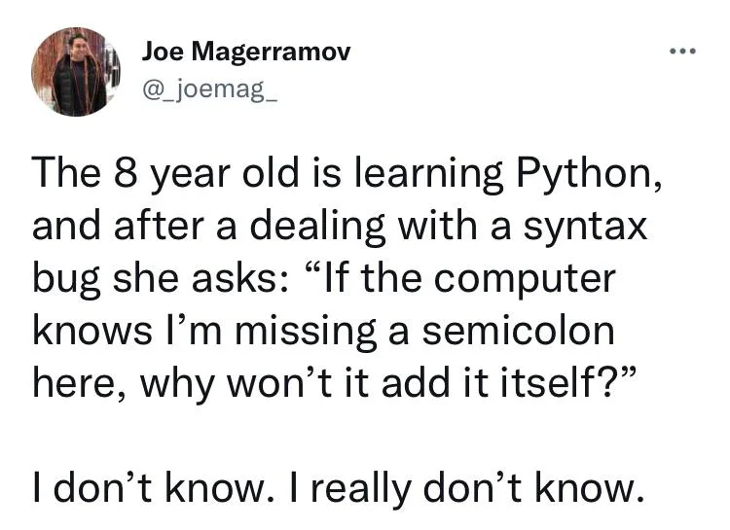
Assignment 2 Structure (3) – assuming you want to do subset2
.grip/current_branch.txt
.grip/trunk/commit_logs.txt
.grip/trunk/commits/0/file.txt .grip/trunk/index/file.txt
.grip/branch1/commit_logs.txt .grip/branch1/commits/0/file.txt .grip/branch1/commits/1/file.txt .grip/branch1/index/file.txt
Folder structure should look something like this
echo blah > file.txt
grip-init
grip-add file.txt
grip-commit –m ’first commit’
grip-log
grip-branch branch1
grip-checkout branch1
echo blah >> file.txt
grip-add file.txt
grip-commit –m ’second commit’
grip-log
grip-show 0:file.txt
grip-show 0:file.txt

Slide 8
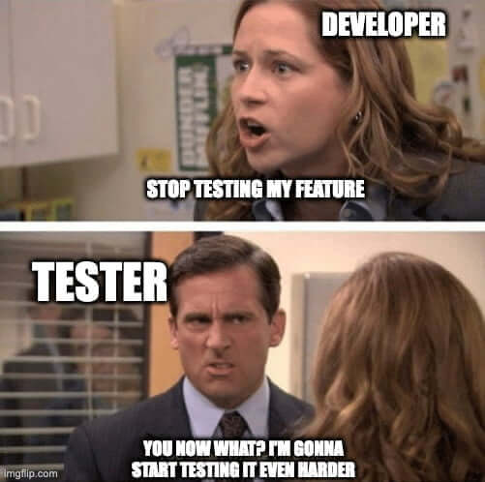
Additional Notes
We will not be testing unthinkable super weird cases
e.g.
Spamming 1000000 files within .grip and checking if your computer crashes or not
Checking the time complexity / space complexity of your implementation
Manually checking what your file structure looks like (All tests will be black box testing)
But try to play around with the implementation a lot

Slide 9
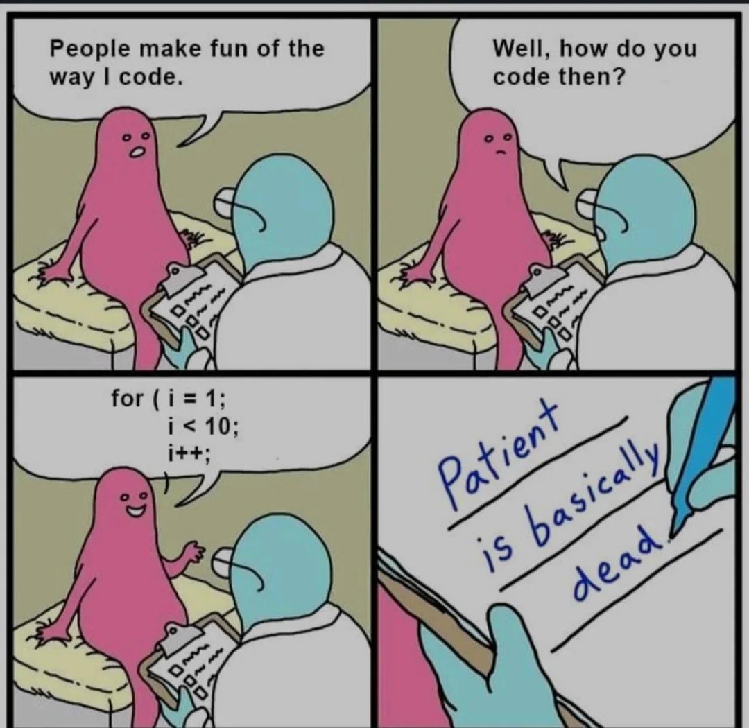
Style & Tests
Don’t do anything stupid
Inconsistent indentations (Tabs of size 4 and 2 mixed)
Inconsistent amounts of newlines
Commenting in another language
Follow style guides from Assignment 1 (Good commenting & Consistency)
Header comments
Commenting before large chunks of code
Descriptive variable names (no magic numbers like a, b, c, i, j, k)
Consistent newlines
Consistent spacing
Consistent tabs
“Will someone else have tremendous difficulty reading your code?”
Test scripts: Do the same thing from assignment 1 (Shell scripting, again)
Everything is the same, just that you’re testing python files instead of shell files

Slide 10
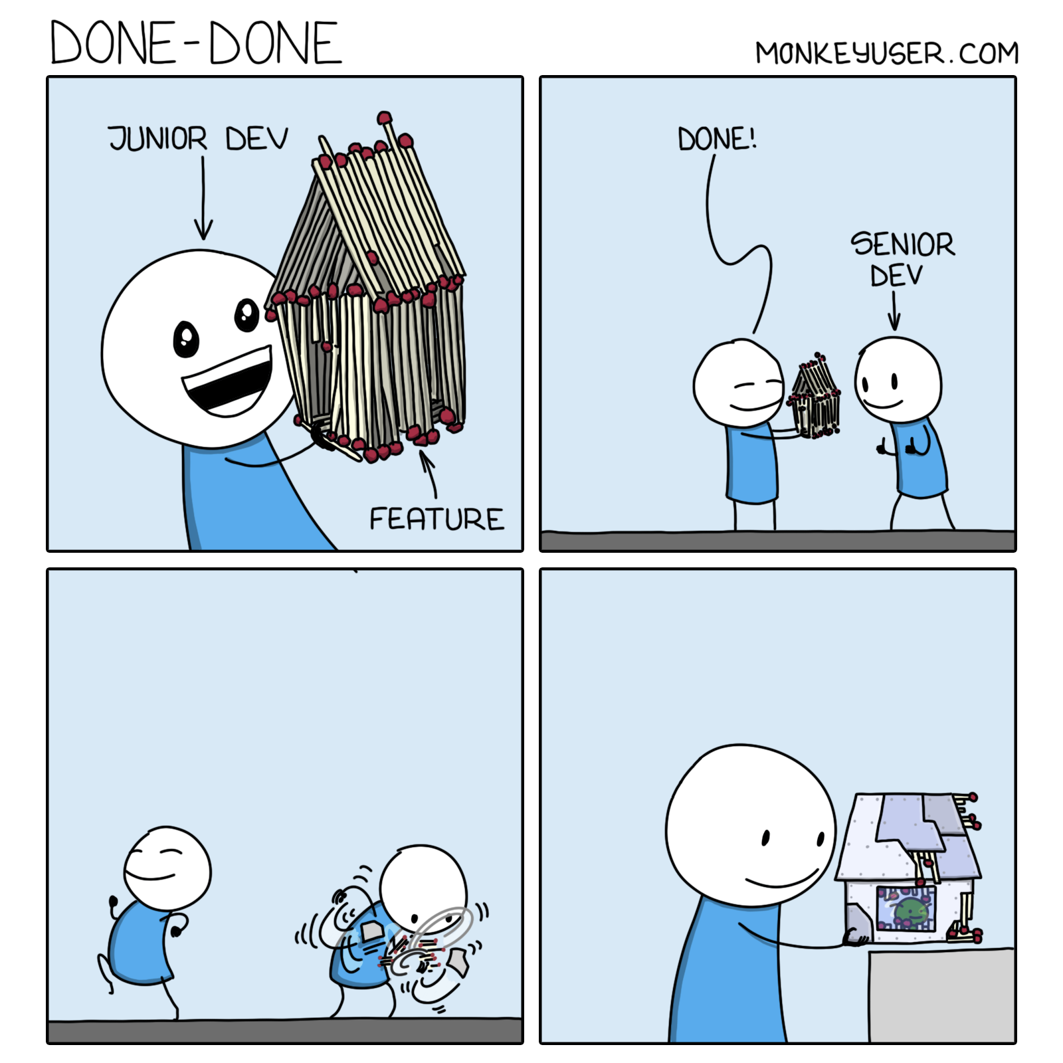
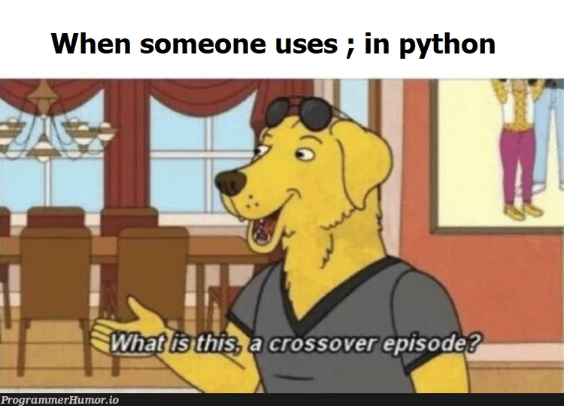
Tutorial Questions

Slide 11

To The
Lab!

